Slide 1
Quantum Computing Meetup Delhi 2020 IIIT-Delhi IndiaQ IBM
2nd February 2020
Notes:
1

Slide 2
Why are we here?

Slide 3
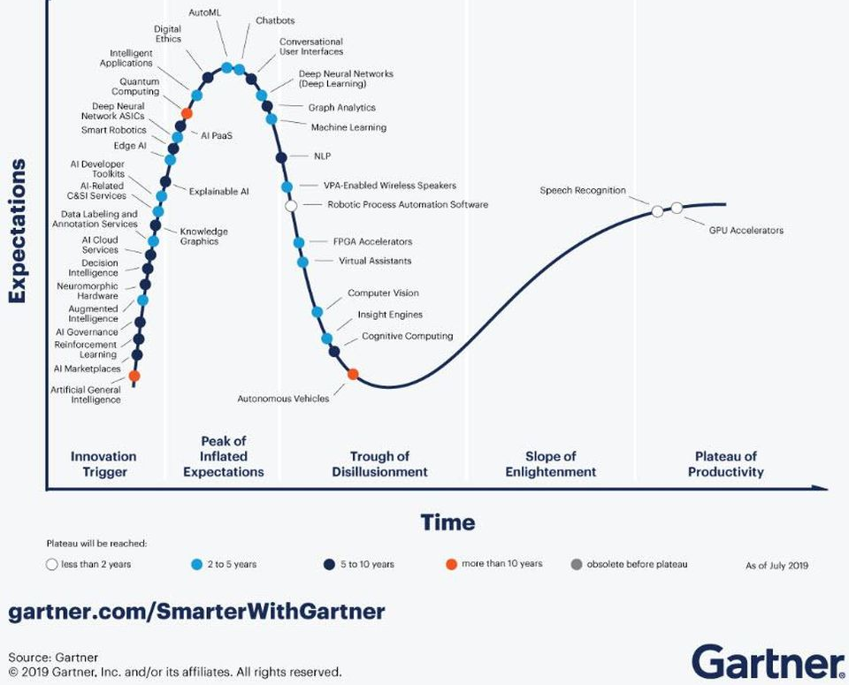
Gartner Hype Cycle

Slide 4
Emerging Technologies in AI
AI cloud services
Autotion of ML
Augmented intelligence
Explainable AI
Edge AI
Reinforcement learning
Quantum Computing … has the potential to make significant contributions to the areas of systems optimization, machine learning, cryptography, drug discovery, and organic chemistry. Although outside the planning horizon of most enterprises, quantum computing could have strategic impacts in key businesses or operations.
AI Marketplaces

Slide 5
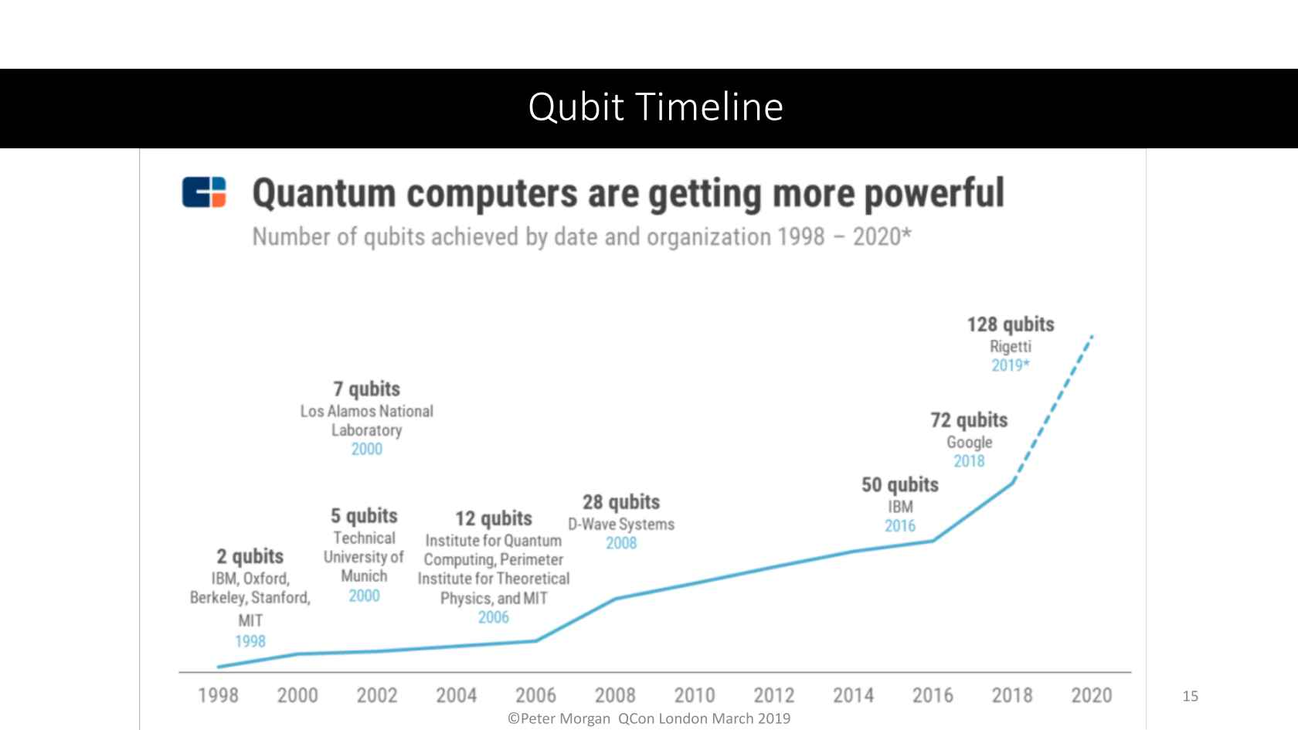
Rise in technology

Slide 6
History
1900 Plank: quantized nature of radiation
1905 Einstein: quantum of light – photon
1924 Louis de Broglie: particle-wave duality
1926 Schroedinger: wave (quantum) mechanics
1981 Feynman: concept of quantum computer to simulate quantum mechanical systems
1985 Deutsch: universal quantum computer
1994 Shor: prime factorization algorithm
1996 Grover: unordered search algorithm
2000 TU Munich: 5-qubit NMR computer
2001 IBM + Stanford: factorization of 15 using 7 qubits

Slide 7
Recent Past
2011 D-Wave: commerical launch, 128 qubit
2016 IBM: 5-qubit cloud QPU
2017
D-Wave: 2000 qubit quantum annealer
IBM: 16-qubit, 20-qubit cloud QPU
Microsoft: 40-qubit cloud-based simulator
Intel: 17-qubit superconducting chip
Google: open source lib. for quantum chemistry
IBM: QISKIT

Slide 8
2019
IBM: 53 qubits and enhanced IBM Q experience through Terra, Aer, Aqua, Ignis frameworks
Rigetti: 32-qubit cloud QPU
Microsoft: Azure Quantum announced, devices from IonQ, Microsoft, etc.
Intel: QPU controlled chip Horse Ridge
Google: 54 qubit that achieved proof-of-concept quantum supremacy
Amazon: Quantum computing on AWS Bracket
Rigetti acquires QxBranch
Xanadu AI: Pennylane for machine learning on QPUs

Slide 9
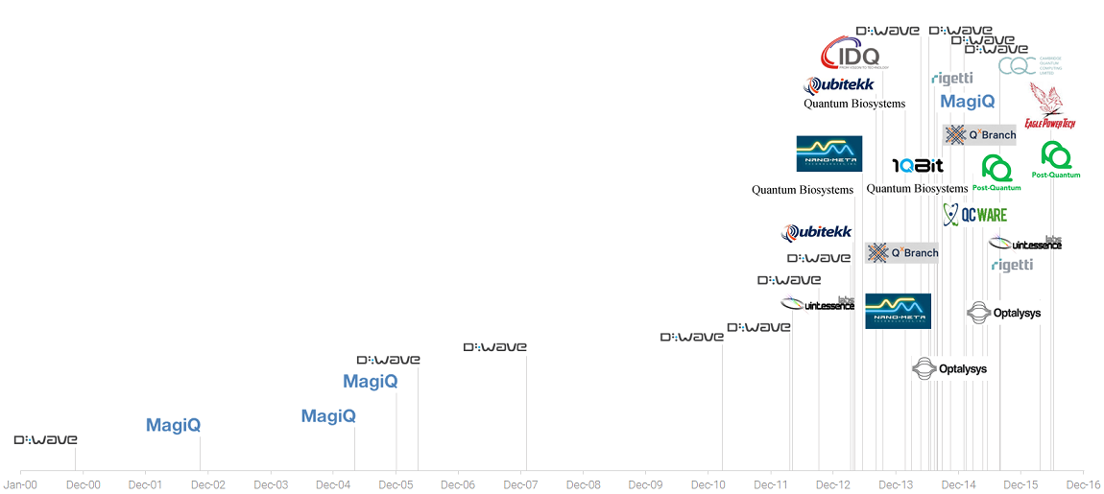
Startup Financing
2000
2001
2002
2005
2010
2014

Slide 10
Where are you?

Slide 11
IIIT Delhi
Created by an Act of Govt. of NCT as an autonomous institution (2008)
11

Slide 12
Academics & Research
80 regular faculty
50+ visiting & adjunct
PhD from IITs/IISc in India & reputed univs. worldwide
Computer Science & Engineering
Electronics and Communications Engineering
Mathematics
Research Centers
* Cybersecurity and Systems Research Center
* Center for Computational Biology
* Infosys Center for Artificial Intelligence
* Center on Design and New Media
* Center for IT and Society
* Center for Technology and Policing
IIIT-D
Computational Biology
Social Sciences
Human Centered Design
12

Slide 13
Academics & Research
6 B.Tech. programs …
Computer Sc. & Eng.
Electronics & Comm. Eng.
CS & Applied Maths
CS & Design
CS & Social Sciences
CS & Bio Science
Computer Science & Engineering
Electronics and Communications Engineering
Mathematics
IIIT-D
3 M.Tech. programs …
CSE, ECE & CB
4 Ph.D. programs …
CSE, ECE, CB & Maths
Computational Biology
Social Sciences
Human Centered Design
13

Slide 14
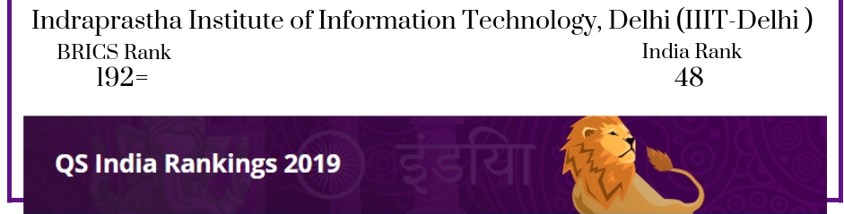
Co-Academic activities
IIITD Incubation & Innovation Center: 10+ startups
FooBar competitive programming club
ICPC World Competition finalists in 2019 2020
Summer, Winter schools on maths, IoT, big data, Social networking, security …
NIRF ranks 66 in Engineering category
14

Slide 15

Who we are?
Theoretical Computer Science Lab

Slide 16
People
Debajyoti Bera, PhD (Boston University)
Research interest: quantum computing + …
PhD students: Tharrma, Sagnik
Research interns: Harsh (Univ. of Edin), Nakul (NSIT)
B.Tech & M.Tech. students: Shanu, Rohit (BITS)
B.Tech. interns: … <longer list>
16

Slide 17
Academic & Research Activities
Quantum random number generators
Fault detection of quatum circuits
Randomization in quantum algorithms
Quantum algorithms in cryptography and optimization
Quantum computing education
“Introduction to quantum computing” course
(recent) Team of 4 students won 2nd prize in
IBM Q Teach Me Quantum Challenge
17

Slide 18

India Quantum Computing Meetup,
New Delhi 2020
Event made possible by ...
Tharrma, Sagnik, Saif, Reshan, Karamjeet,
Harsh, Yajur, Praveek
DEPARTMENT OF COMPUTER SCIENCE AND ENGINEERING

